Slide 1
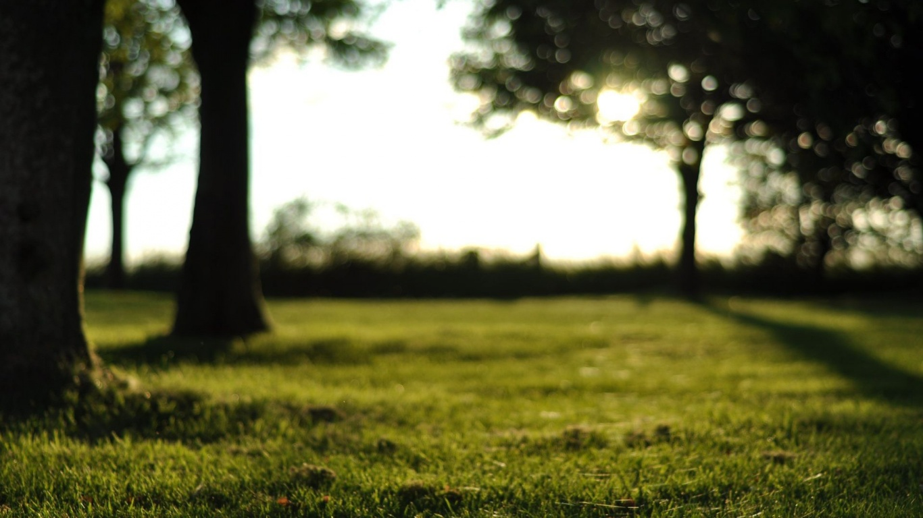
Low-fi Prototyping & Pilot Usability Testing
承洋、際禎、凱捷、George、Wei Yang

Slide 2
Mission Statement / Value Proposition
Mission:
To raise awareness and ultimately slow down the epidemic of near-sightedness
Introducing a new wearable, smart glasses, to seamlessly notify user and record data of everyday eye activities
Proposition:
Eye (I) need help: smartGlasses provide users data, notify them to rest and encourage good activity to earn rewards.

Slide 3
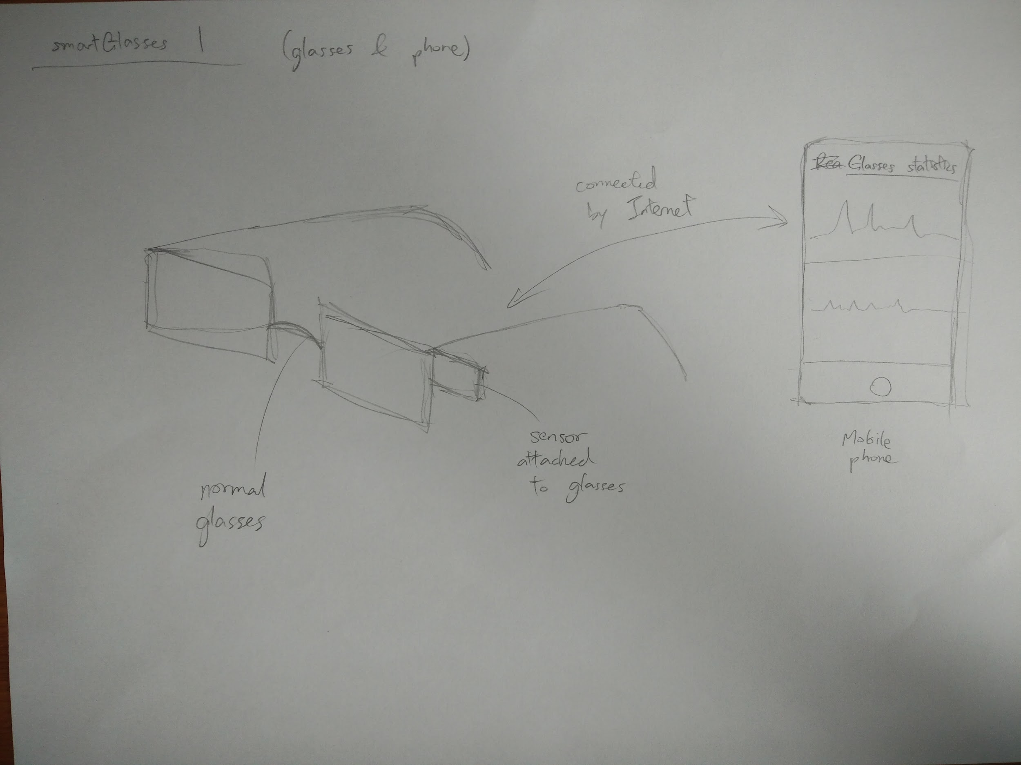
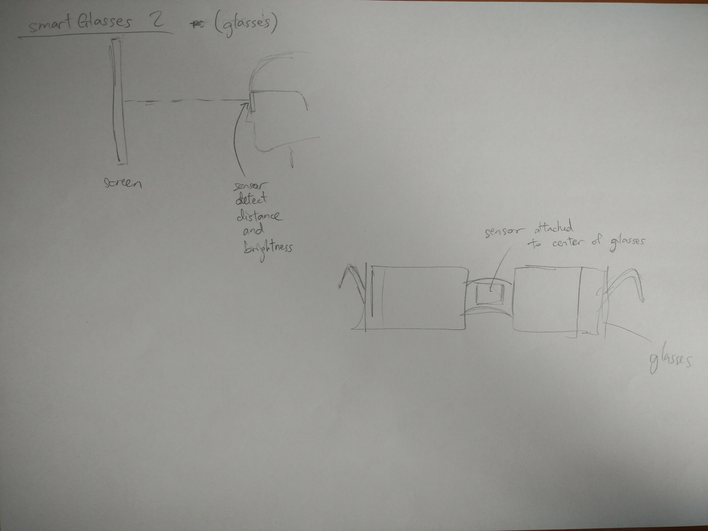
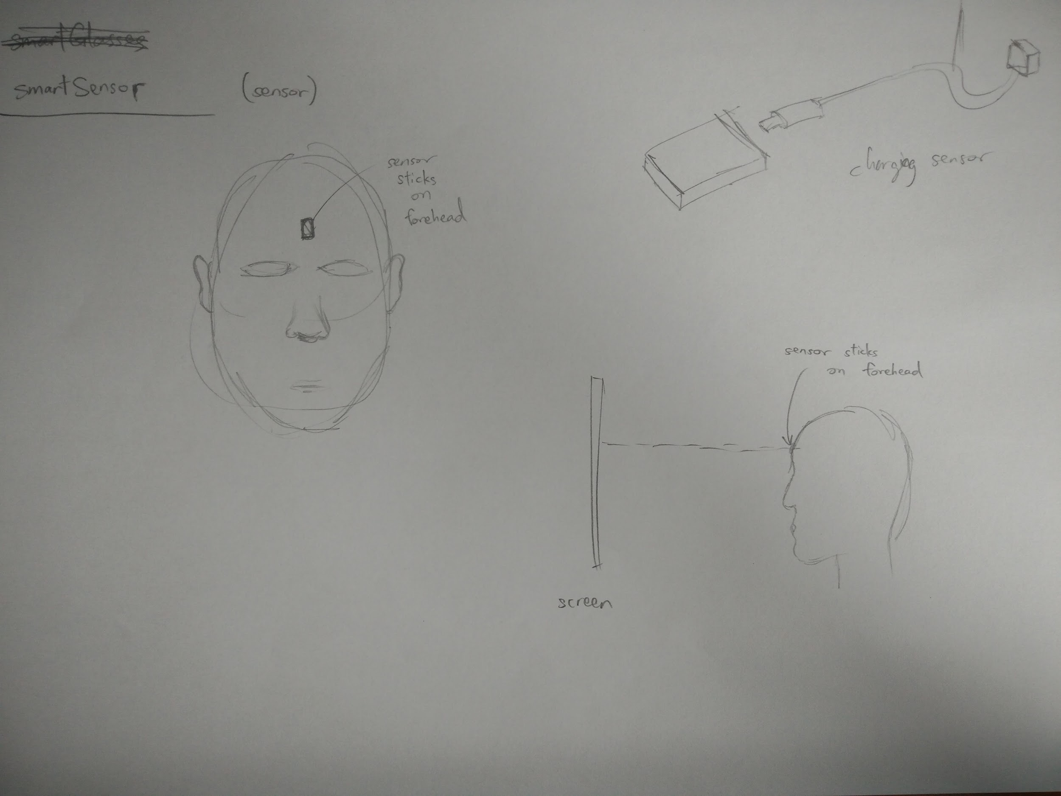
Initial UI Sketches

Slide 4
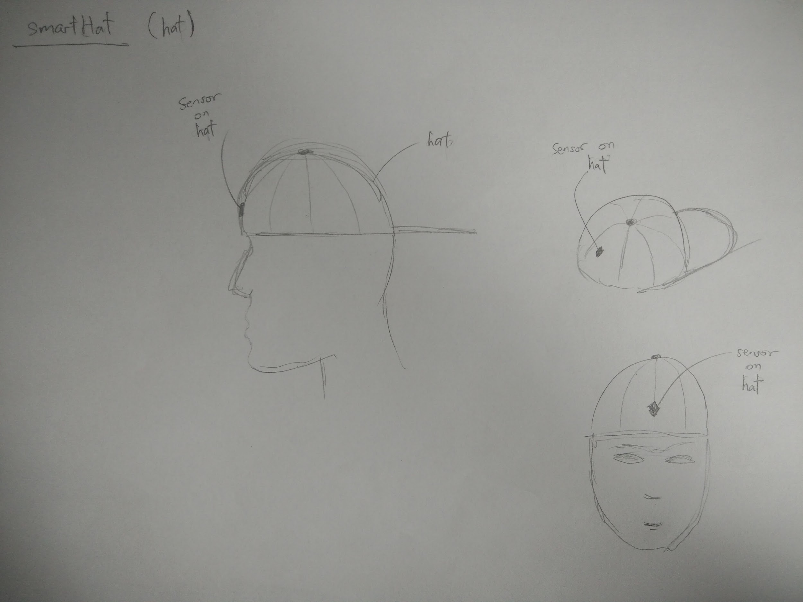
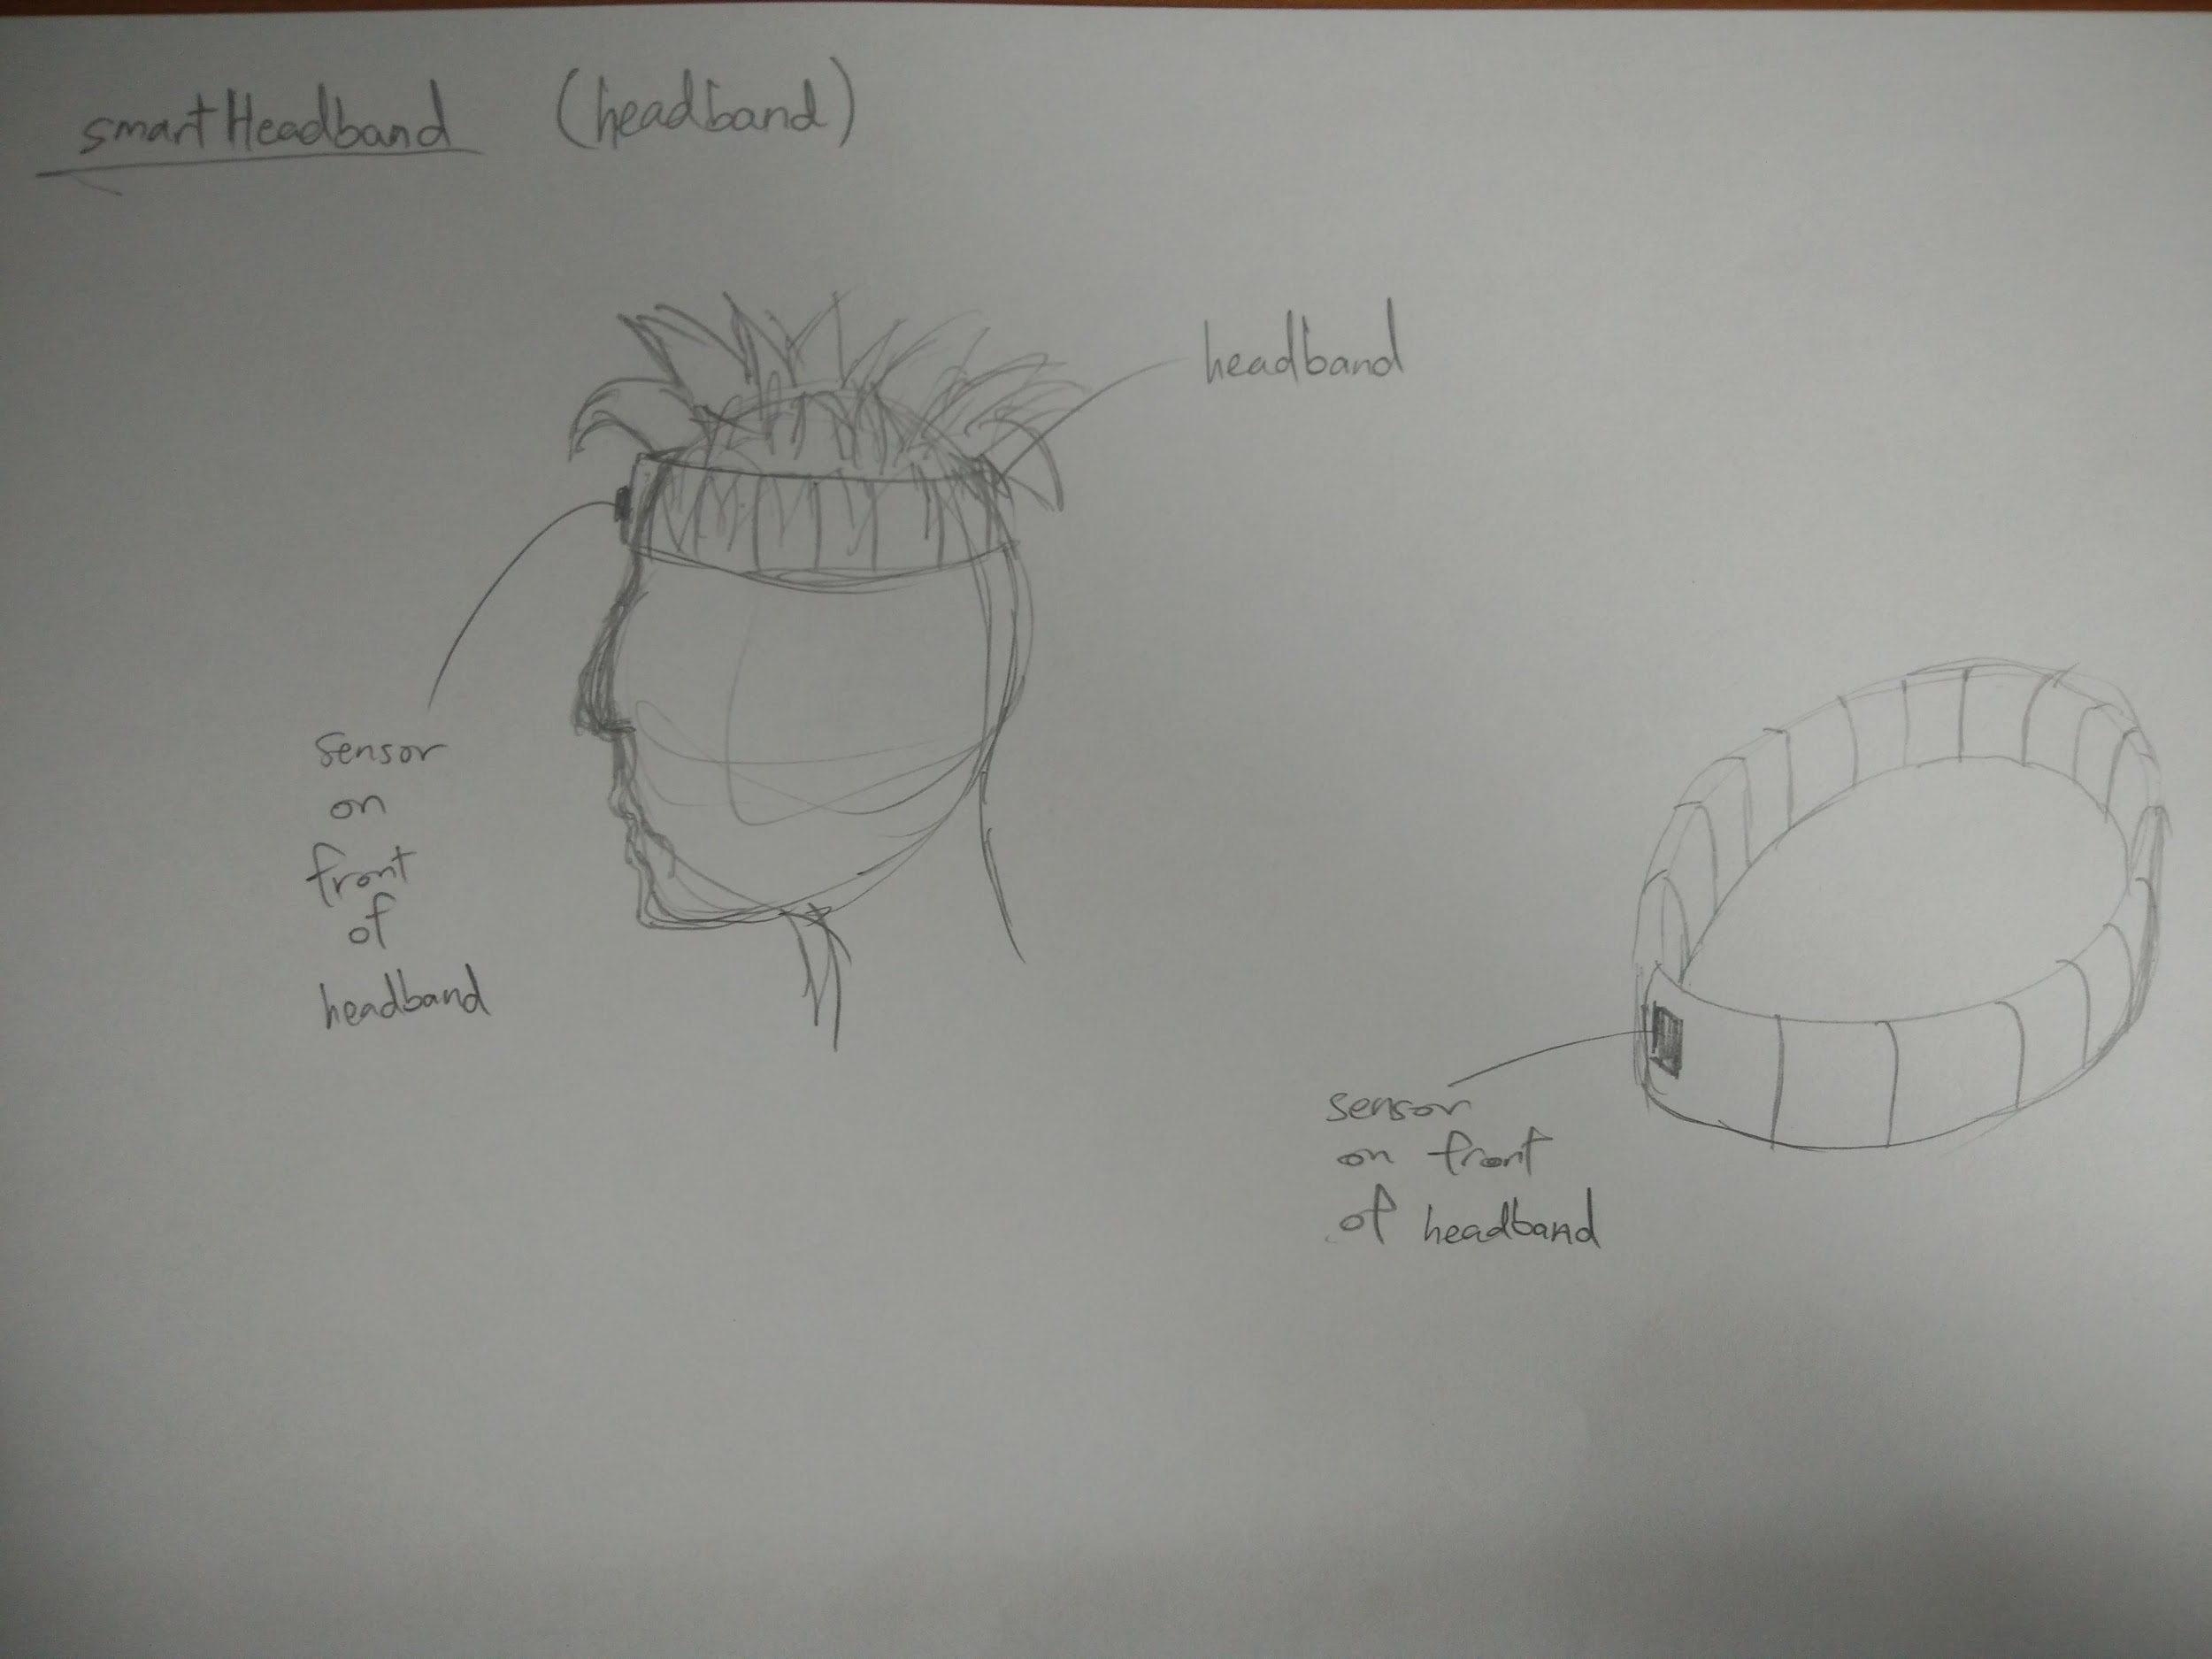
Initial UI Sketches

Slide 5
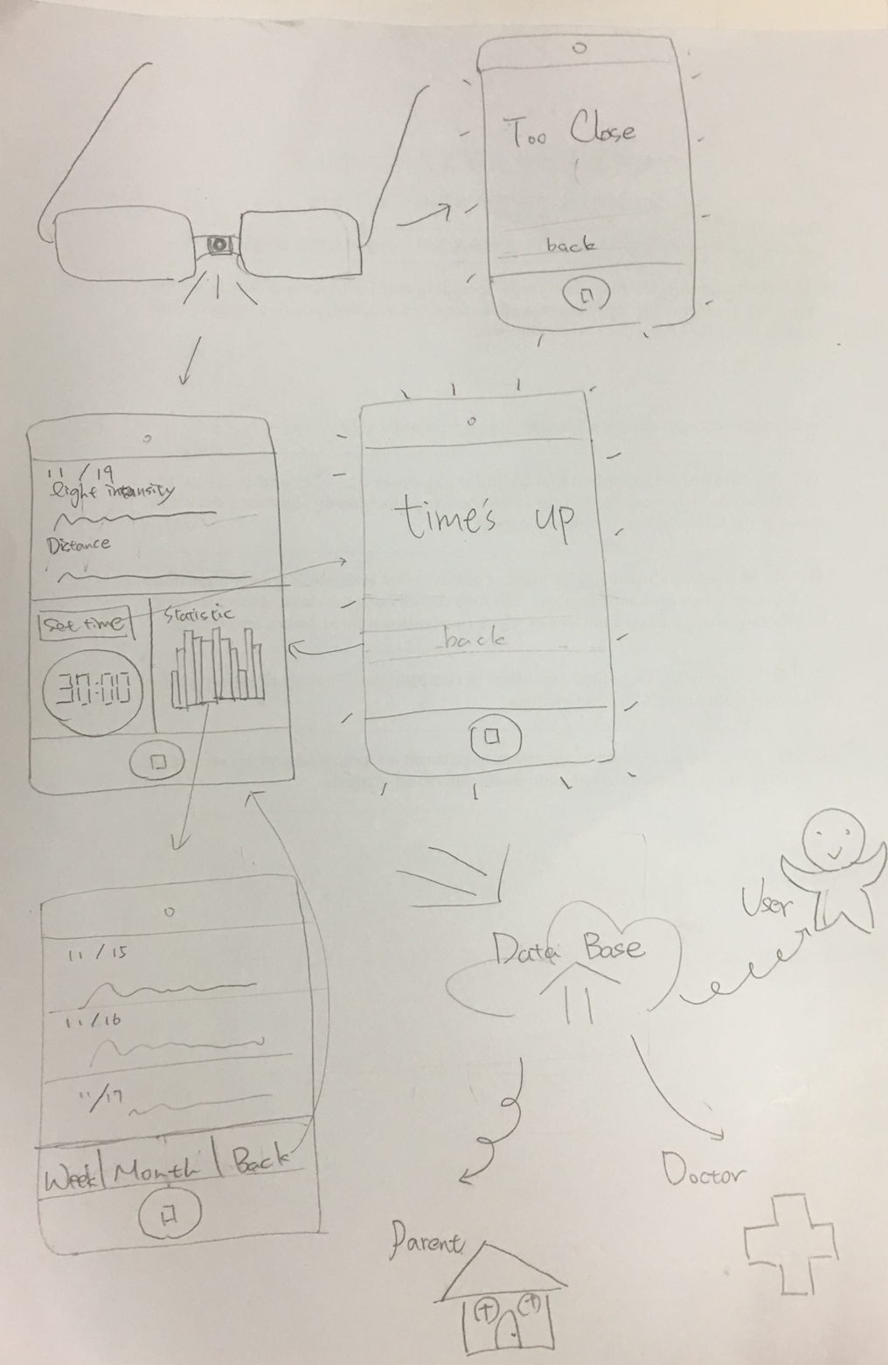
Selected Interface & Rationale
Overview Design

Slide 6
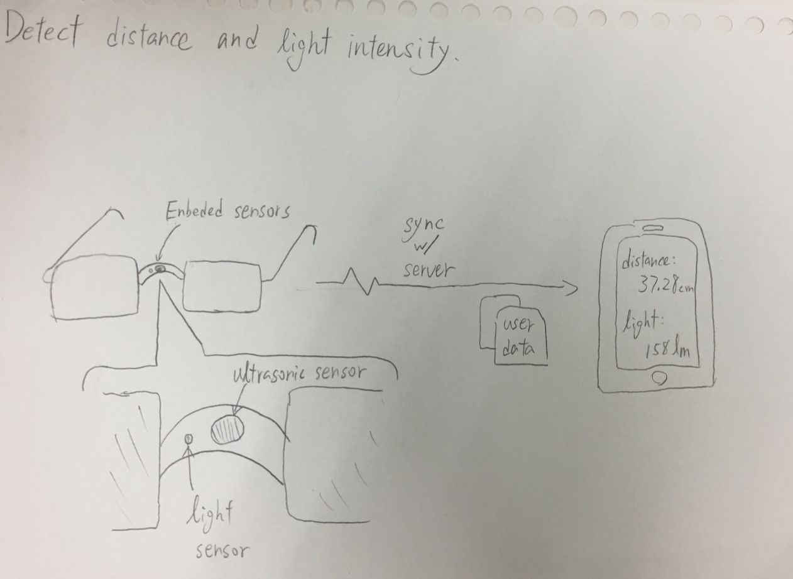
Low-fi Storyboard
(1) Detect Distance and Light Intensity

Slide 7
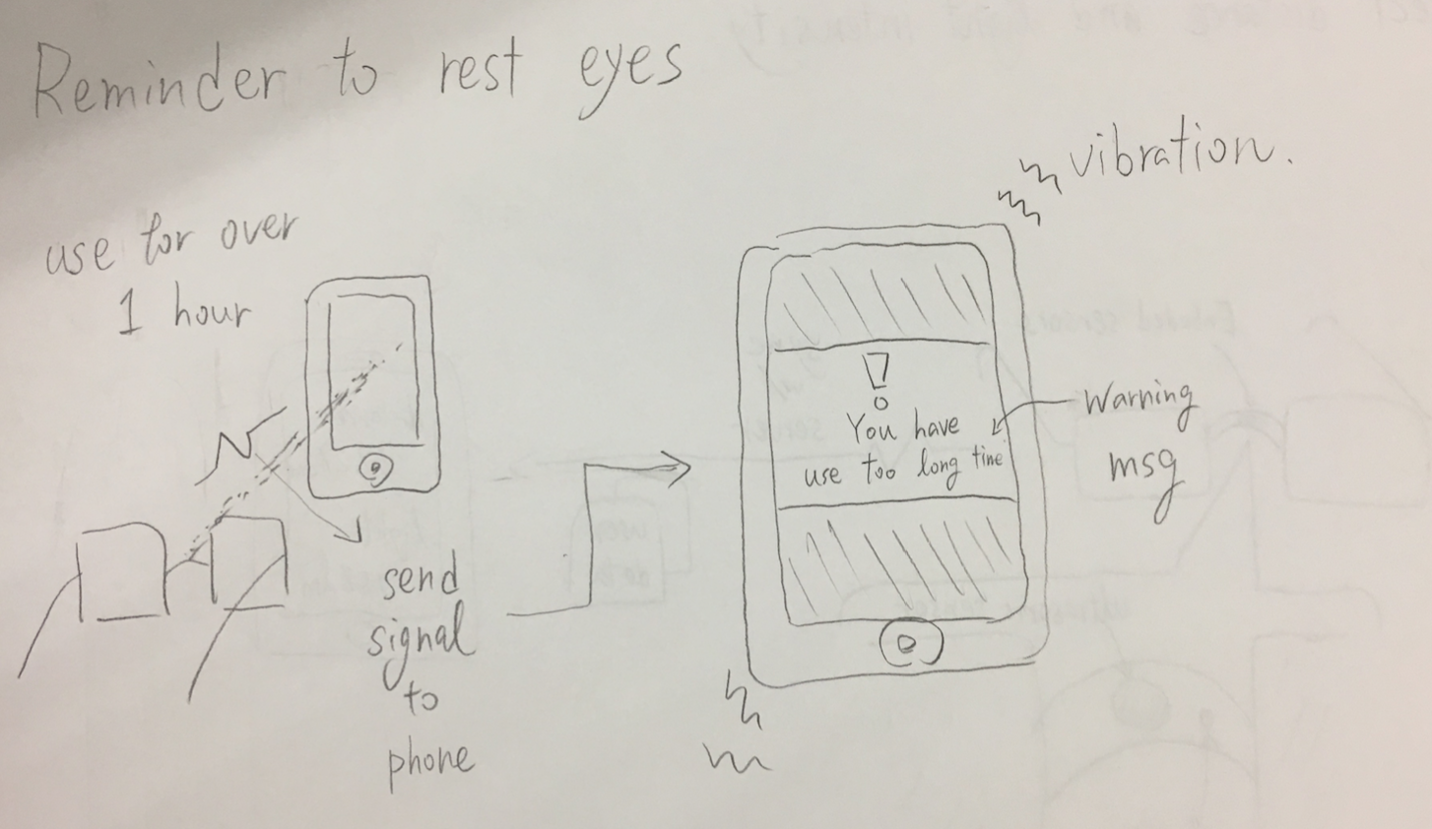
Low-fi Storyboard
(2) Reminder/Notification

Slide 8
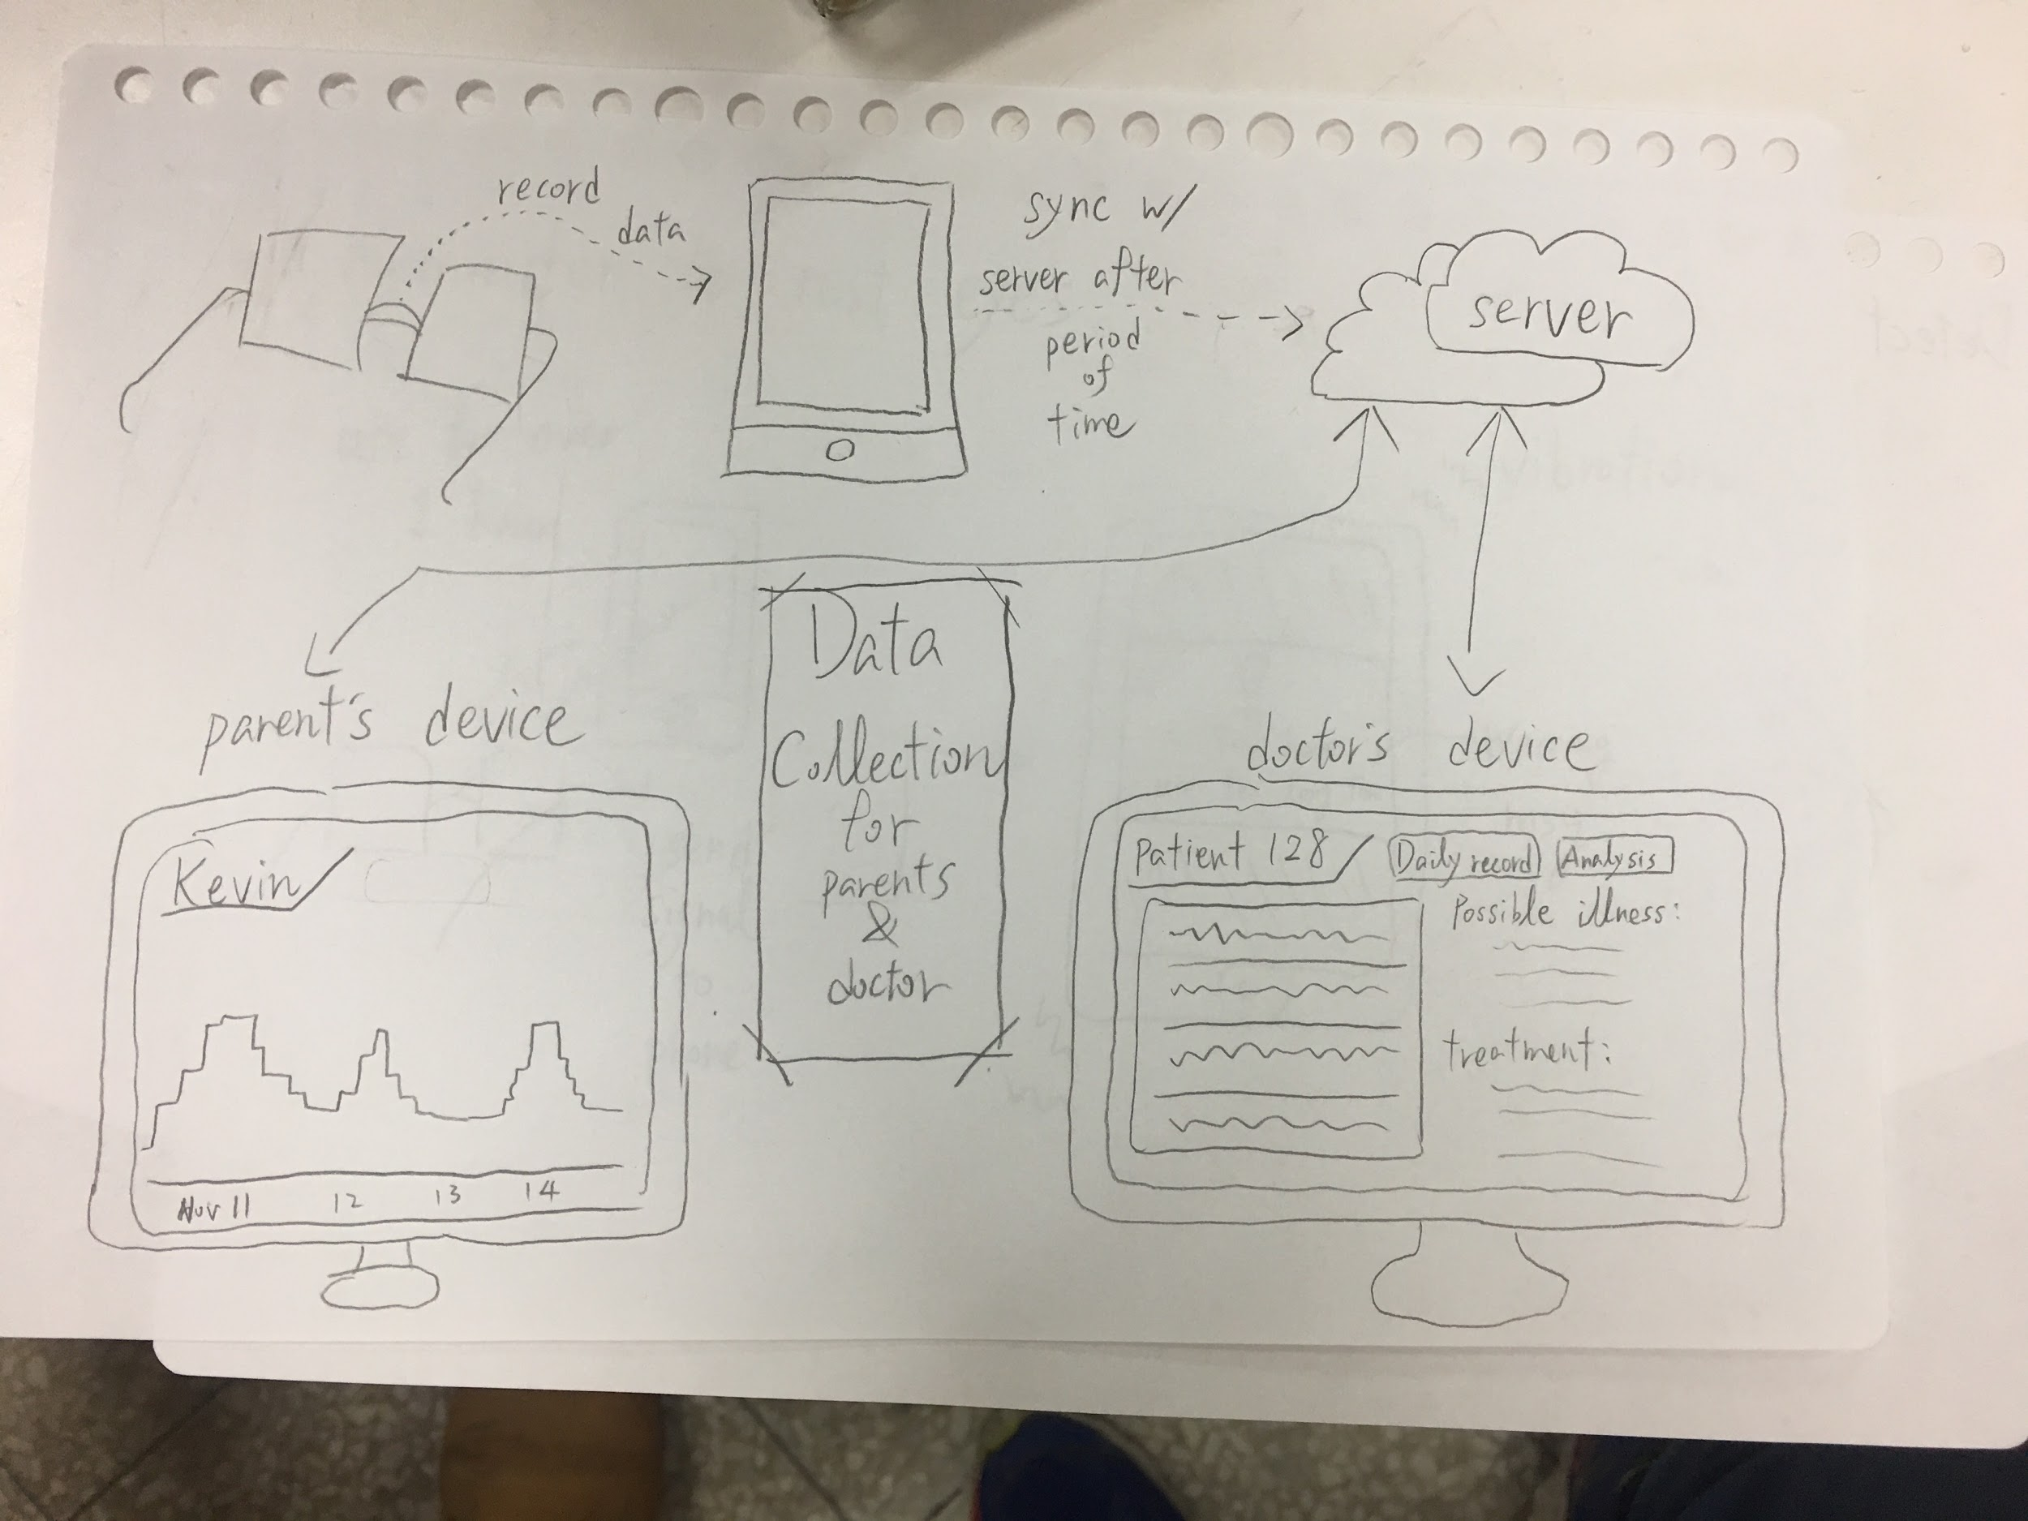
Low-fi Storyboard
(3) Data Cloud

Slide 9
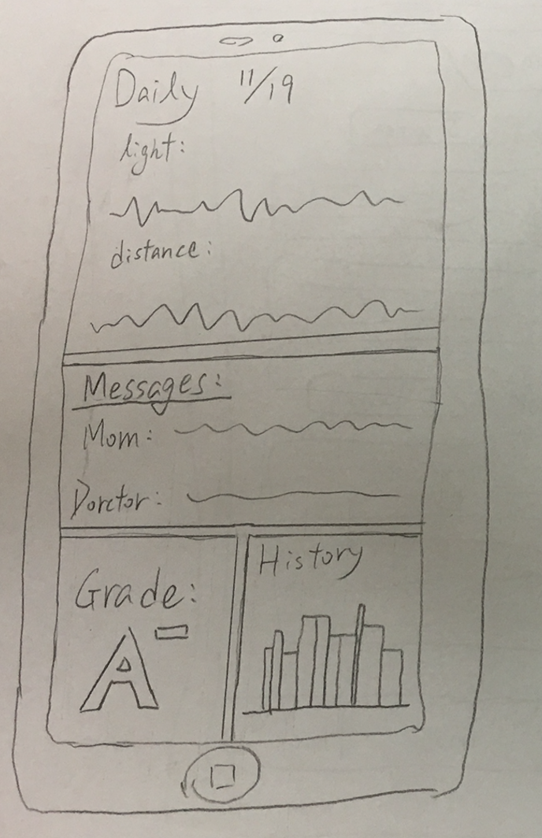
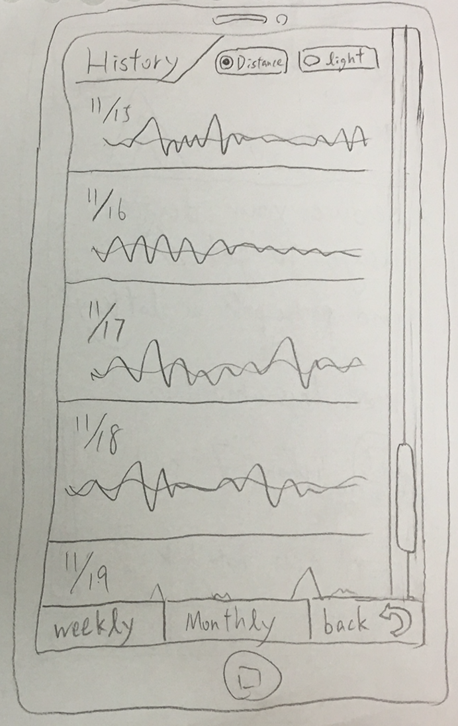
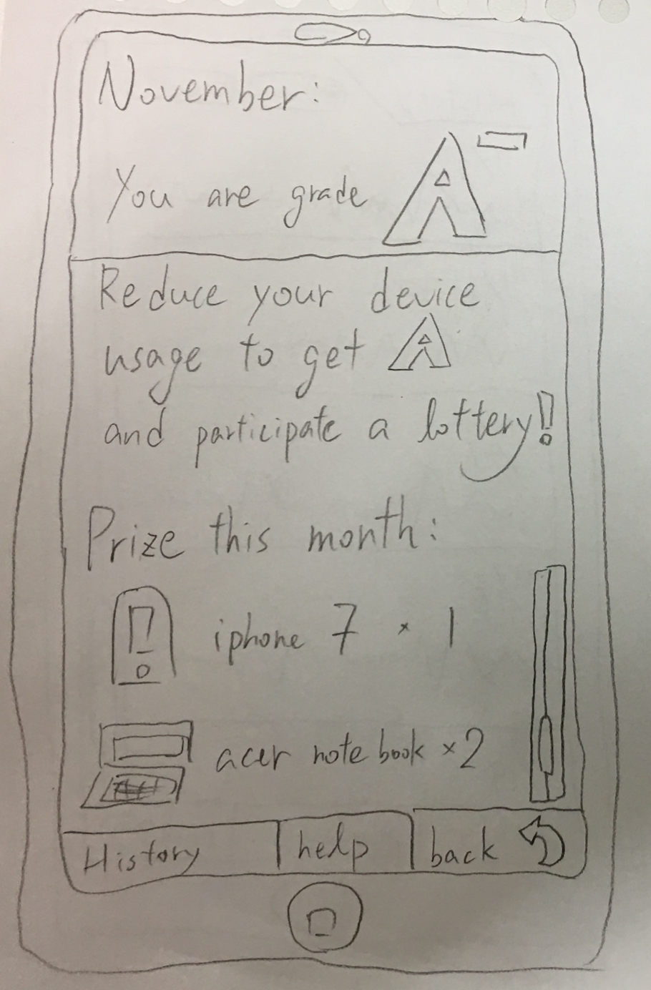
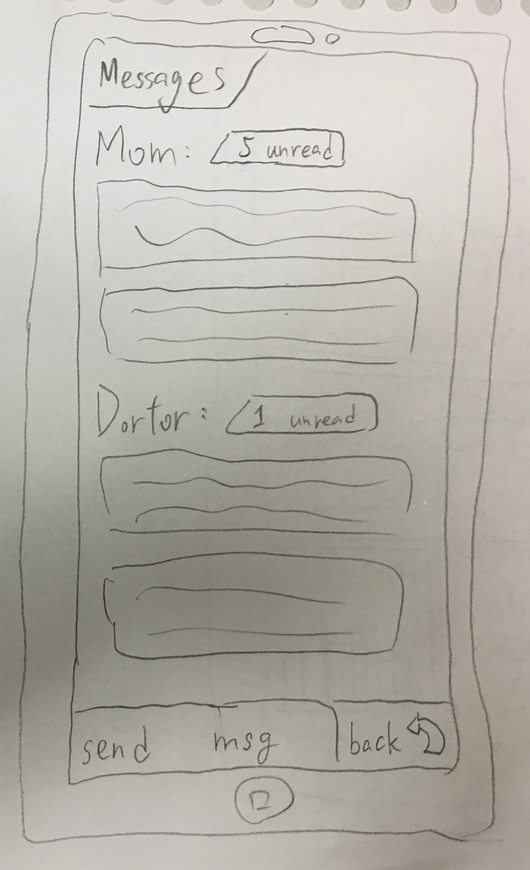
Low-fi Prototypes

Slide 10
Tasks and Flows
Put on the glasses
Go through the low-fi UI
Demonstrated the warning messages and graphs
During the experiment, we check where the user pressed intuitively and observe whether they paused to think for long

Slide 11
Feedback
In the UI, “set time” is not intuitive enough
What does “distance” stand for?
User wondered if it the phone is always receiving signal? Privacy Concerns?
Young kids may not set the time by themselves
Parents may not have time to analyze graph/chart daily

Slide 12
Suggested UI Changes
Change the placement of “Set Time” and let timer starts automatically after sensor detection
“Statistics” section changed the wording to history
The app provides some simple analytics, or summary, of the collected data, graphs. Pinpoint the most important info.

